Slide 1

Be Complete
Isaiah
Dr. Rick Griffith • Crossroads International Church Singapore
CICFamily.com • BibleStudyDownloads.org

Slide 2
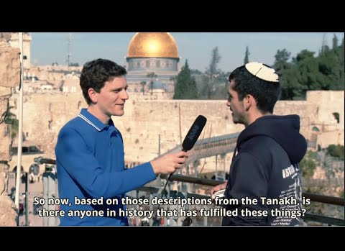
"The Forbidden Chapter" in the Hebrew Bible
Isaiah 53
Notes:
23-Isaiah 53 'The Forbidden Chapter' in the Hebrew Bible.mp4 (https://www.youtube.com/watch?v=cGz9BVJ_k6s)

Slide 3
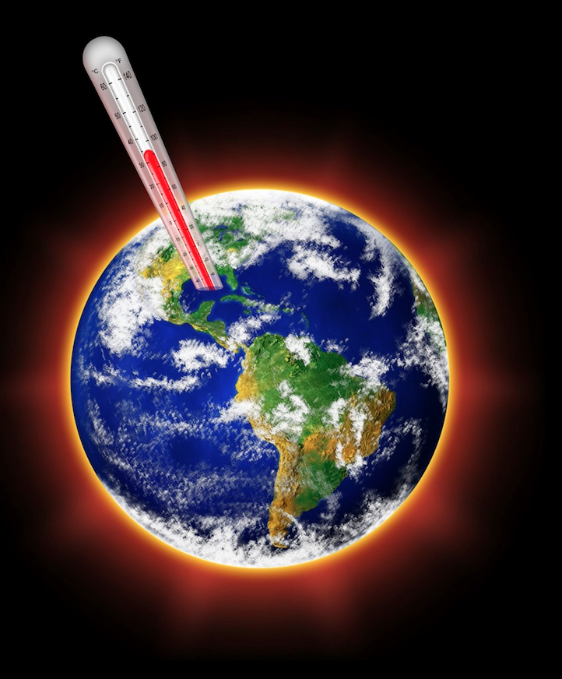
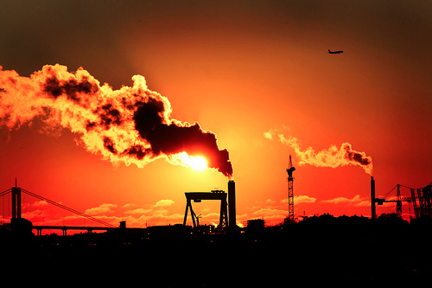
The Talk of the Town Today
452
Global Warming
Notes:
As Christians we know that Isaiah 53 relates clearly to Jesus. Sometimes things are so obvious that we miss them! For example, today people speak of global warming but God speaks of global warning.

Slide 4
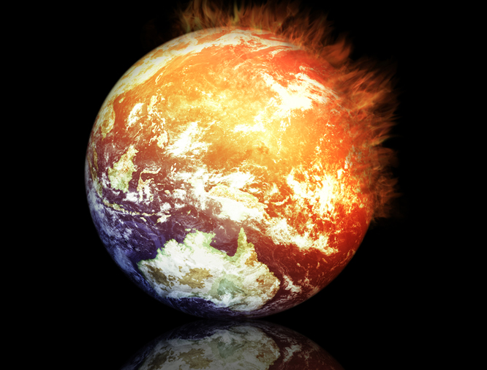
A Study of Isaiah
452
Global Warning
Notes:
Do you know of God’s global warning?
It relates to this Suffering Servant in Isaiah 53. It means that we will warn us and save us before he completes his plan for the ages.

Slide 5
How will God complete his plan for all creation?
Notes:
By what means will the LORD restore the entire universe?

Slide 6
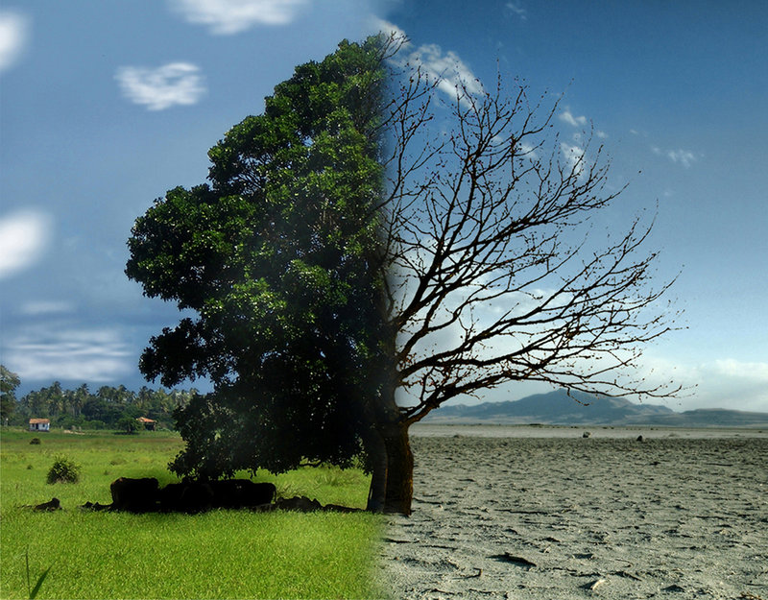
Theology of Humanism
452
343
Present
Future
Notes:
Humanism teaches that man is destroying himself—and that climate change is the result of carbon emissions and other man-made problems.

Slide 7
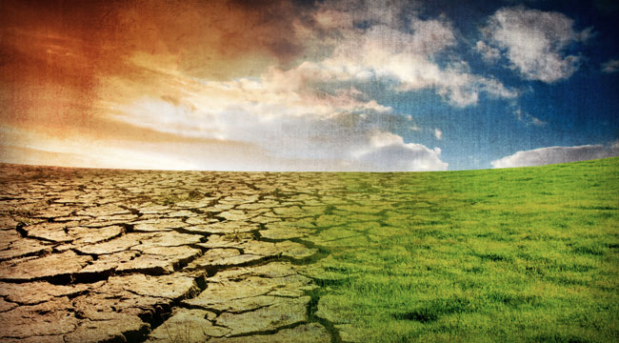
Isaiah's Key Idea
452
343
Judgment
Salvation
Notes:
In contrast to humanism, God says that he will judge the world, but then renew it—or restore it.

Slide 8
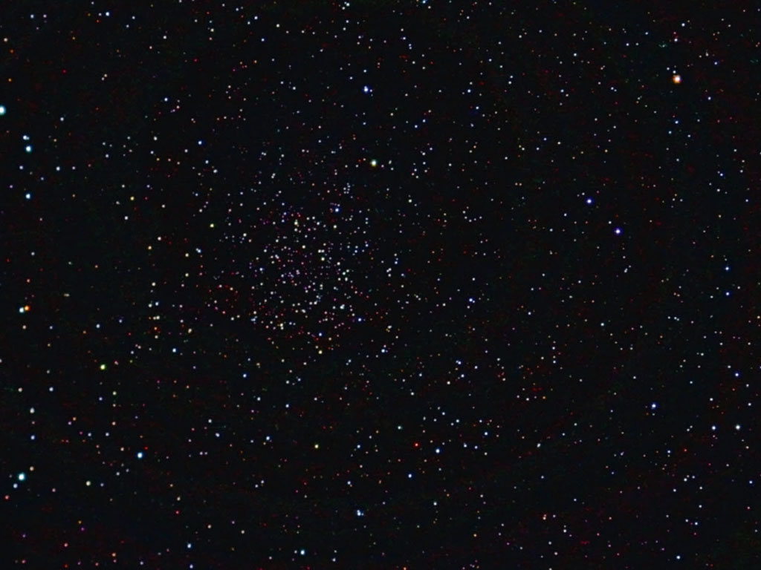

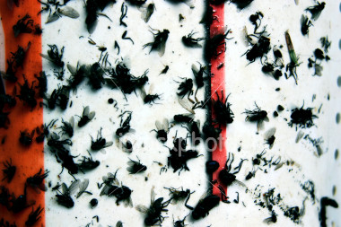
452
Key Verse:
"Lift up your eyes to the heavens, look at the earth beneath; the heavens will vanish like smoke, the earth will wear out like a garment and its inhabitants die like flies. But my salvation will last forever, my righteousness will never fail."
(Isa. 51:6 NIV)
Notes:
8

Slide 9
Overview of the Future
437
Great
White
Throne
(Rev. 20:11-14)
Rapture
(1 Thess. 4:13-18)
2nd Advent
(Zech. 14:3-5)
Church Age
Tribulation
(Zech. 14:1-2)
Millennium
(Zech. 14:6-21)
Gog & Magog
(Armageddon)
(Ezek. 38–39)
Gog and Magog
Revisited
(Rev. 20:7-10)
Notes:
9
God’s timeline is found in other passages.

Slide 10


Revelation 20:4-6 Diagrammed
NTS 424
^{4b}and they came to life and reigned with Christ for a thousand years.
^{4a}Then I saw thrones, and they sat on them, and judgment was given to them. And I saw the souls of those who had been beheaded because of their testimony of Jesus and because of the word of God, and those who had not worshiped the beast or his image, and had not received the mark on their forehead and on their hand…
1000 years
^{5b}This is the first resurrection. ^{6a}Blessed and holy is the one who has a part in the first resurrection; over these the second death has no power…
^{6b}but they will be priests of God and of Christ and will reign with Him for a thousand years.
^{5a}The rest of the dead did not come to life until the thousand years were completed.
Notes:
Here is the only place in Scripture where we find the actual length of the kingdom era as 1000 years—and it mentions it six times in

Slide 11
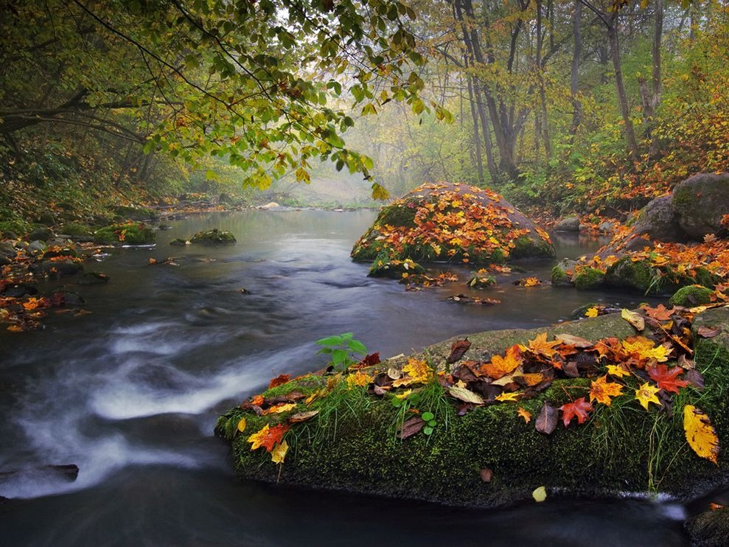
Purposes of the Millennium
NTS 424
Judge angels (1 Cor. 6:3)

Slide 12
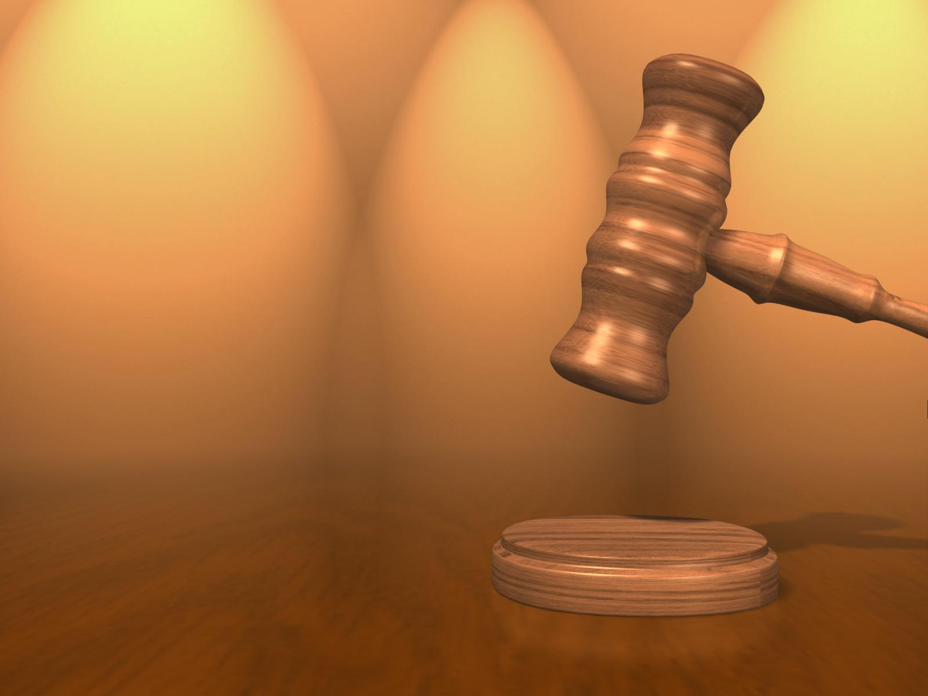
We are more competent than unbelievers to solve Christian disputes
(1 Cor. 6:2-6, 9-11)

Slide 13
"Don't you realize that someday we believers will judge the world? And since you are going to judge the world, can't you decide even these little things among yourselves? ³Don't you realize that we will judge angels? So you should surely be able to resolve ordinary disputes in this life"
(1 Cor. 6:2-3 NLT)

Slide 14
Purposes of the Millennium
NTS 424
Judge angels (1 Cor. 6:3)
Rule the earth (1 Cor. 6:2)

Slide 15
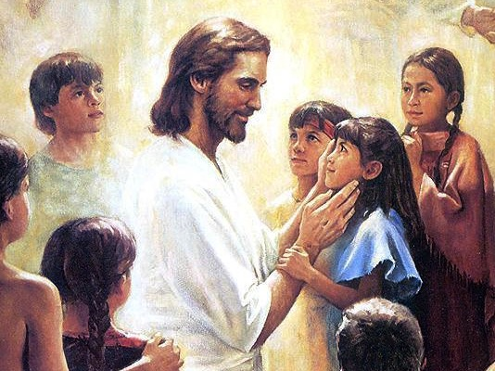
Christ will have a Spirit-led and righteous rule (11:1-5)
Christ will have a Spirit-led and righteous rule (Isa. 11:1-5)

Slide 16
Purposes of the Millennium
NTS 424
Judge angels (1 Cor. 6:3)
Rule the earth (1 Cor. 6:2)
Restore world to pre-Flood era (long life of Isa. 65:20)

Slide 17
Incredibly Long Life (NIV)!
NTS 424
NIV Isaiah 65:20 "Never again will there be in [Jerusalem] an infant who lives but a few days, or an old man who does not live out his years; he who dies at a hundred will be thought a mere youth; he who fails to reach a hundred will be considered accursed."
Notes:
17

Slide 18
Purposes of the Millennium
NTS 424
Judge angels (1 Cor. 6:3)
Rule the earth (1 Cor. 6:2)
Restore world to pre-Flood era (long life of Isa. 65:20)
Show the human heart corrupt
Fulfill Abrahamic Covenant

Slide 19
Kingdom & Covenants Timeline
22 &
337
9g
Kingdom Teaching...
Adam rules with God (Gen. 1:26, 28; 2:19)
Satan rules as god of this world (Gen. 3:15;
2 Cor. 4:4)
God covenants with Abraham to reestablish man's rule via Israel as a "kingdom of priests" (Gen. 12:1-3; Exod. 19:6)
Israel's failure to witness to nations as a kingdom of priests is judged via exile under foreign rule
Israel rejects Messiah's offer of kingdom (Matt. 12:41-42; 23:37-39)
Jesus extends His kingdom in mystery form to the Church (Matt. 13)
Christ subdues Israel's enemies and nation believes (Rom. 11:26-27)
Christ rules over everything with saints (Eph. 1:9-10; Rev. 20:1-6; 22:5b)
Fall of Man (Gen. 3)
Noahic Covenant
Genesis 6:18; 9:8-17
Land Covenant
ISRAEL
CHURCH
MESSIANIC KINGDOM
(National Focus)
The "New Man" (Eph. 2:15)
Millennial Eternal
land
Genesis 15:18 (cf. Deut. 30:1-10) promises:
Land from Wadi of Egypt to Euphrates River (Isa. 27:12)
Eternal possession of land (Gen. 17:8) after exile/restoration
Whole world blessed via the land (Isa. 14:1-2)
Israel judged for rejecting Messiah by dispersion away from land for 19 centuries
(AD 70–AD 1948) but now partially restored (Ezek. 37:1-7)
Full restoration (Ezek. 37:8-28) Jerusalem world capital
(Isa. 2:1-5)
New Jerusalem
(Rev. 21–22)
Davidic Covenant
Christ is Head over His Church, which is a spiritual temple (Eph. 2:19-22; 2 Cor. 6:16)
Christ reigns over the world
(Isa. 11)
with saints (Rev. 5:10; 20:4-6)
Christ hands kingdom over to Father (1
Cor. 15:24)
Abrahamic Covenant
2 Samuel 7:12-16 promises perpetual:
Sons ("house" never wiped out)
Kingdom (political dynasty)
Throne (right to rule by descendants)
Temple (son to build it)
Genesis 12:1-3
seed
New Covenant
All
things made new!
(Rev. 21:5)
All 5 elements fulfilled in national restoration (Zech. 8)
Jeremiah 31:31-34 promises:
Forgiveness
Indwelling Spirit
New heart, nature, mind
Reunification of Israel and Judah
No need for evangelism
Mosaic Law replaced with first three elements of the New Covenant (Luke 22:20; 2 Cor. 3:6)
blessing
Mosaic Covenant
Law abolished, fulfilled, and replaced at the cross (Rom. 7:1-6;1 Cor. 9:19-21; Heb. 8:13)
Sixth Edition
15 June 2012
Temporary (Gal. 3:19) and conditional (Deut. 28) to reveal sin (Rom. 7:7) and regulate Israel (Gal. 3:23-25)
Scripture has a dual kingdom-covenant emphasis. Israel's role from Abraham to Christ expands to include the Church (continuity) yet the Church never replaces the nation as the "new Israel" (discontinuity). Israel will again enjoy world prominence after trusting in Christ at His second coming.
Notes:
Slides 13 and 127 repeated

Slide 20
Placing the Prophets
342
Placing the Prophets
Key Dates
931
Obadiah
722
Jonah
Amos
Hosea
Isaiah
Micah
586

Slide 21

When Isaiah Wrote
453
End of the
Kings of Israel
Pekah
Hoshea
Kings of Judah
Uzziah
Jotham
Ahaz
Hezekiah
Isaiah's 60-Year Ministry
(739-680 BC)
Notes:
21

Slide 22
The Assyrian Threat
454
Assyrian Expansion
Nineveh
Mediterranean
Sea
Aram
Israel
Judah
Isaiah 7
Persian
Gulf
Egypt
Notes:
22

Slide 23
How will God complete his plan for all creation?
Notes:
By what means will the LORD restore the entire universe?
There are two stages of God’s future plan.
The whole book Isaiah teaches these two stages that God will fulfill his plan for the universe.

Slide 24
Be Complete
Judgment
1–39
God will judge those who reject him (Isa 1–39).
Notes:
The LORD will deal with unbelievers in a just manner (restatement).

Slide 25
Slides on
Isaiah 1
Notes:
Judah has violated the Mosaic Covenant so God will justly judge the nation (Isa 1–6).

Slide 26
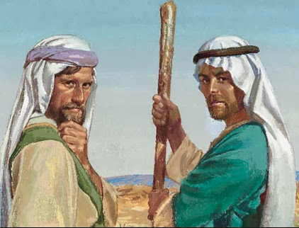
Israel Ignorant (Isa. 1:2)
"Listen, O heavens, and hear, O earth;
For the LORD speaks,
'Sons I have reared and brought up,
But they have revolted against Me'"
(Isa. 1:2 NAU).

Slide 27
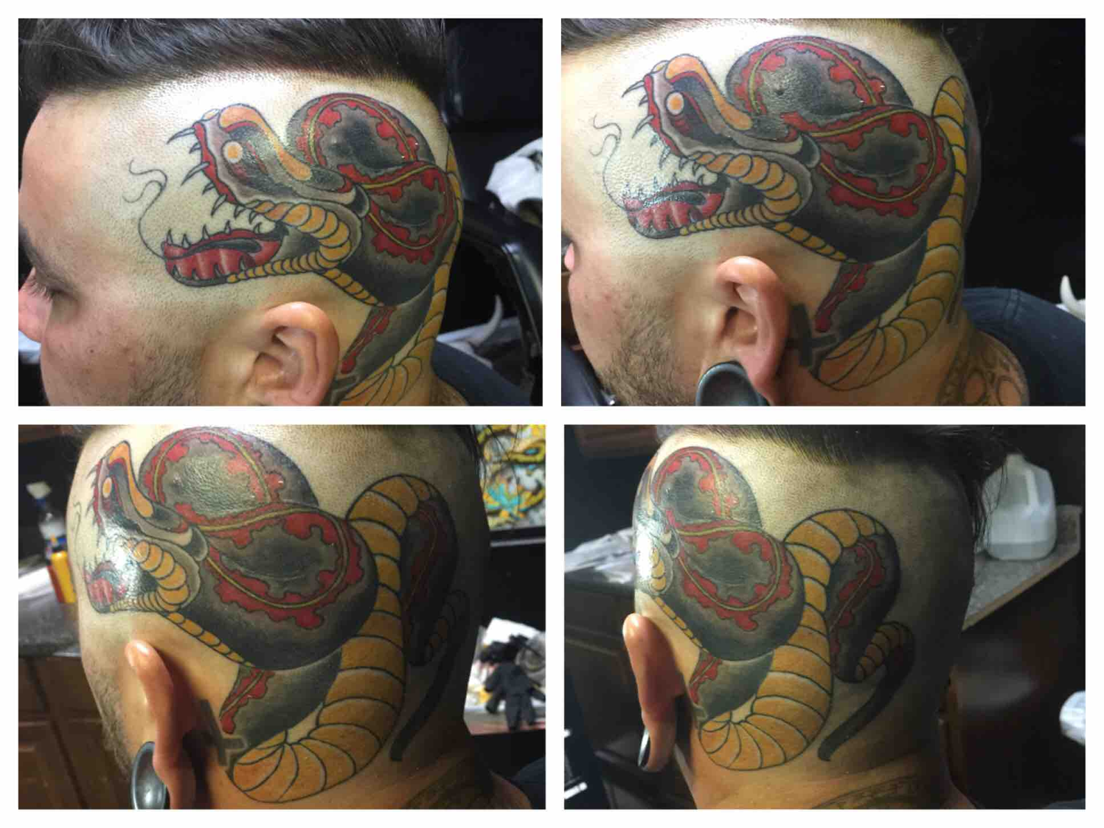
Israel Ignorant (Isa. 1:2)
"Listen, O heavens, and hear, O earth;
For the LORD speaks,
'Sons I have reared and brought up,
But they have revolted against Me'"
(Isa. 1:2 NAU).

Slide 28
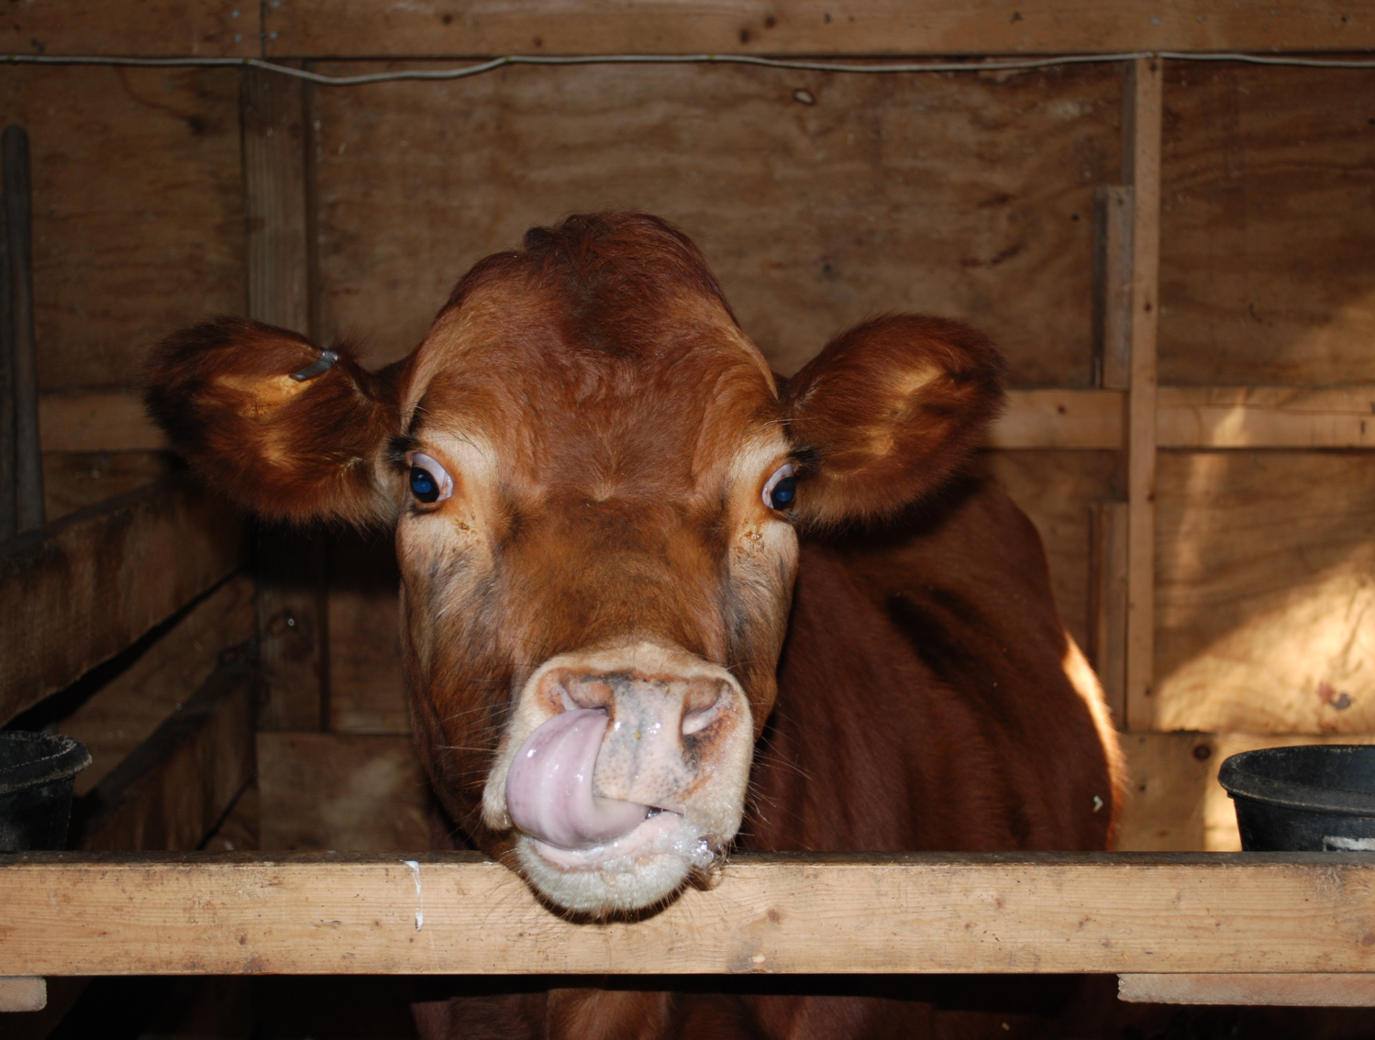
Israel Ignorant (Isa. 1:3)
"An ox knows its owner,
And a donkey its master's manger,
But Israel does not know,
My people do not understand"
(Isa. 1:3 NAU).

Slide 29
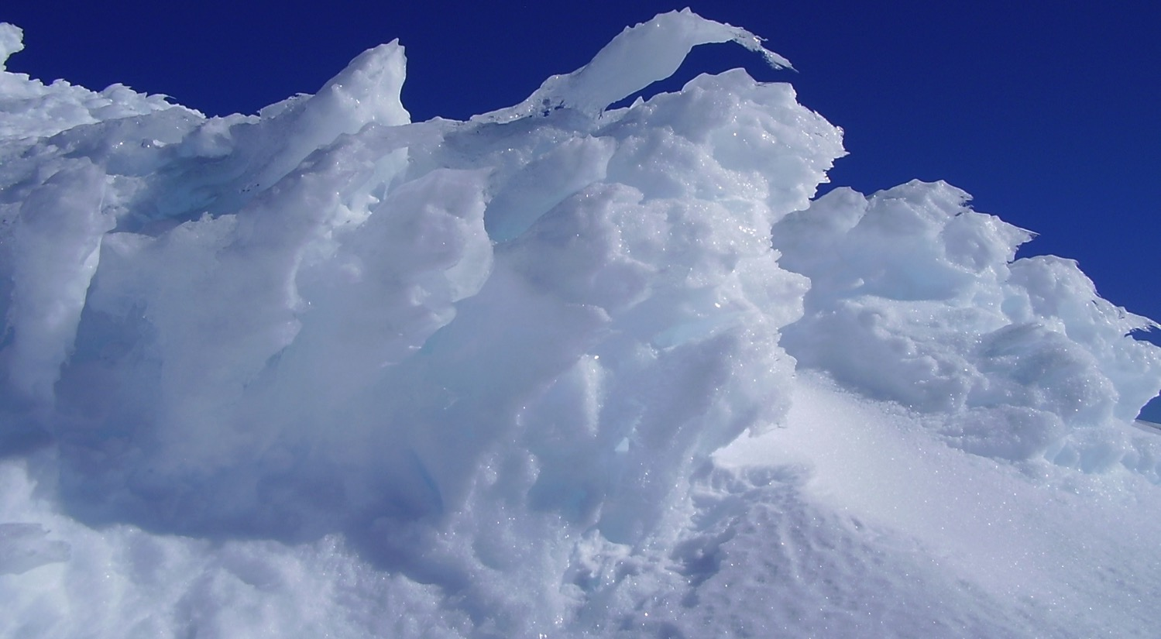

"Come now, let's settle this," says the LORD. "Though your sins are like scarlet, I will make them as white as snow. Though they are red like crimson, I will make them as white as wool"
(Isaiah 1:18 NLT).
Notes:
29

Slide 30
Slides on
Isaiah 6
Notes:
So God called Isaiah to speak his words to a rebellious people until the cities lie desolate (Isa 6).

Slide 31
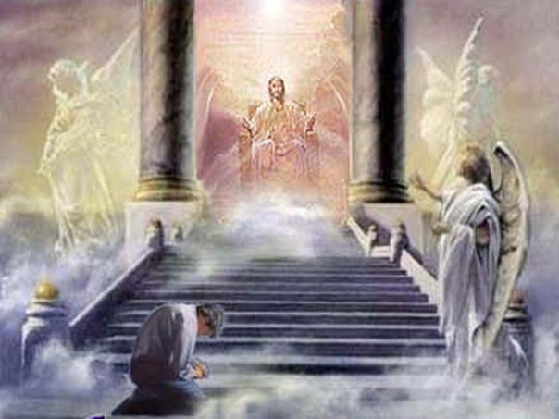
"It was in the year King Uzziah died that I saw the LORD. He was sitting on a lofty throne, and the train of his robe filled the Temple"
(Isa. 6:1 NLT).

Slide 32
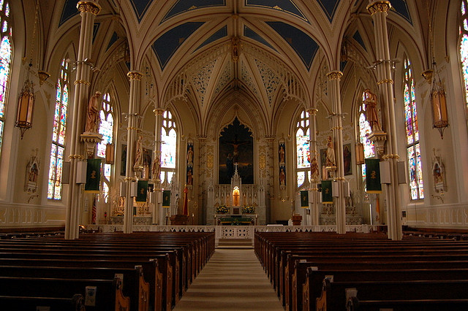
"Attending him were mighty seraphim, each having six wings. With two wings they covered their faces, with two they covered their feet, and with two they flew"
(Isa. 6:2 NLT).

Slide 33
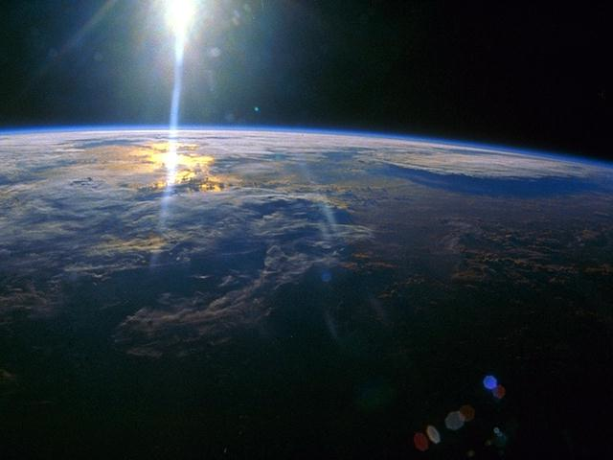
"They were calling out to each other,
'Holy, holy, holy
is the LORD of Heaven's Armies!
The whole earth is filled with his glory!'"
(Isa. 6:3 NLT)

Slide 34
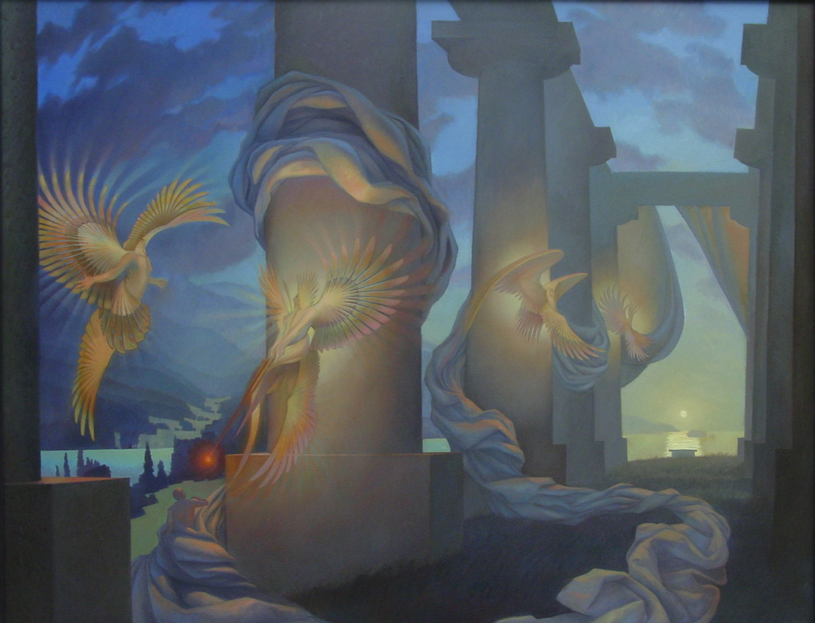
"Their voices shook the Temple to its foundations, and the entire building was filled with smoke.
⁵Then I said, 'It's all over! I am doomed, for I am a sinful man. I have filthy lips, and I live among a people with filthy lips. Yet I have seen the King, the LORD of Heaven's Armies'" (Isa. 6:4-5 NLT).

Slide 35
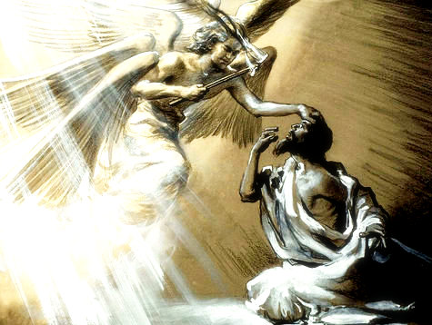
"Then one of the seraphim flew to me with a live coal in his hand, which he had taken with tongs from the altar" (Isa. 6:6 NLT).

Slide 36
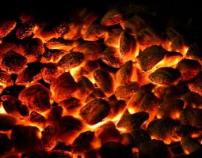
"He touched my lips with it and said, 'See, this coal has touched your lips. Now your guilt is removed, and your sins are forgiven'" (Isa. 6:7 NLT).

Slide 37
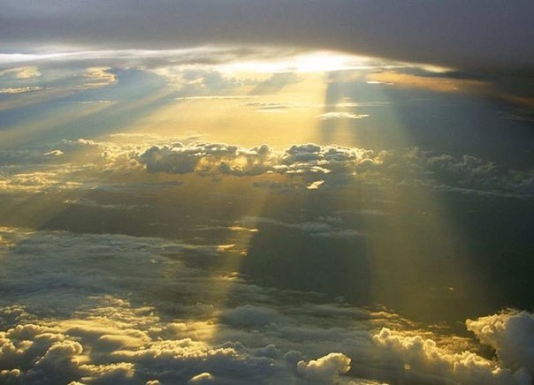
"Then I heard the LORD asking, 'Whom should I send as a messenger to this people? Who will go for us?' I said, 'Here I am. Send me'" (Isa. 6:8 NLT).

Slide 38
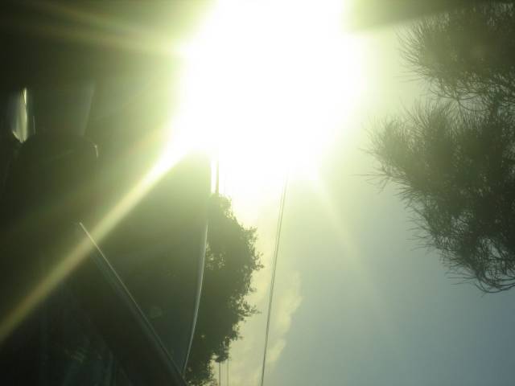
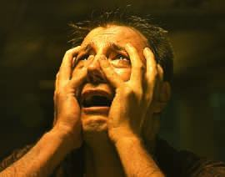

I saw the LORD...
WOE
To me!
I am
RUINED
FORGIVENESS!
Here I am,
SEND ME!
Notes:
38
Isaiah was called to prophesy to a hard and unyielding people in times that were uncertain and changing. He did not know the how long his ministry would be, only that he would be required to keep going through any circumstances until his mission was accomplished. God equipped him for the journey and gave him the tasking. Isaiah could not prophesy in his own strength, he had to depend on God and trust the LORD with his life. In the prophecies given to Isaiah, the LORD asserts His power, sovereignty, faithfulness and compassion over all the people and circumstances Judah was facing.

Slide 39
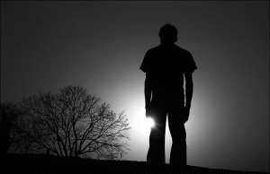
How long, O LORD?
"Then I said, 'Lord, how long will this go on?
And he replied,
'Until their towns are empty,
their houses are deserted,
and the whole country is a wasteland;
¹²until the LORD has sent everyone away,
and the entire land of Israel lies deserted'"
(6:11-12 NLT).
Notes:
If God called you to stubborn people, probably one of your first questions would be, “Well, OK, but for how long?” At least there must be some comfort if you were rejected only for a few weeks or months or years. Perhaps a temporary rejection was on Isaiah’s mind when he asked in verse 11, “How long, O Lord?” Yet what was the answer?
• Until the land is destroyed!
——————
"Lord" in 11a is Adonai

Slide 40
Slides on
Isaiah 7

Slide 41
The Assyrian Threat
454
Assyrian Expansion
Nineveh
Mediterranean
Sea
Aram
Israel
Judah
Isaiah 7
Persian
Gulf
Egypt
Notes:
41
In Isaiah 7, Ahaz sought to take the pressure off him from his two northern neighbors by paying the Assyrians even farther to the north. They said, “Thank you very much! We had planned on conquering Aram and Israel anyway!” But God said he would destroy Aram and Israel within about three years, which seemed inconceivable to Ahaz.

Slide 42
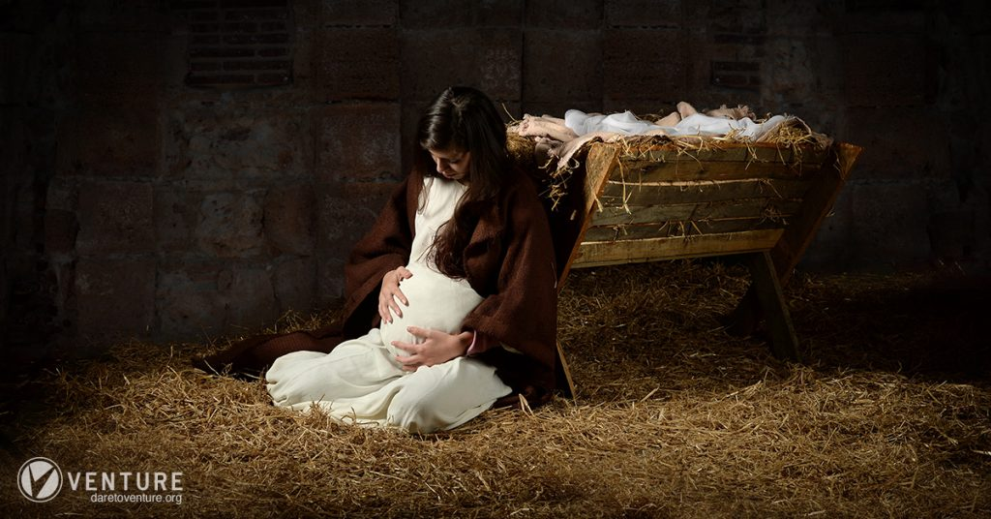
"All right then, the Lord himself will give you the sign. Look! The virgin will conceive a child! She will give birth to a son and will call him Immanuel (which means ‘God is with us’)."
Isaiah 7:14 NLT
Notes:
Later, the Lord sent this message to King Ahaz: 11 “Ask the Lord your God for a sign of confirmation, Ahaz. Make it as difficult as you want—as high as heaven or as deep as the place of the dead.”
Is. 7:12 But the king refused. “No,” he said, “I will not test the Lord like that.”
Is. 7:13 Then Isaiah said, “Listen well, you royal family of David! Isn’t it enough to exhaust human patience? Must you exhaust the patience of my God as well? 14 All right then, the Lord himself will give you the sign. Look! The virgin will conceive a child! She will give birth to a son and will call him Immanuel (which means ‘God is with us’). 15 By the time this child is old enough to choose what is right and reject what is wrong, he will be eating yogurt and honey. 16 For before the child is that old, the lands of the two kings you fear so much will both be deserted.

Slide 43
Slides on
Isaiah 9
Notes:
The idea of God providing security in a child is further developed in Isaiah 9.

Slide 44
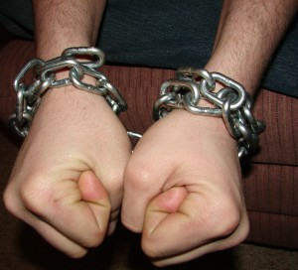

What do you do when you need security?

Slide 45
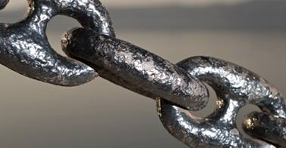
Security is often found in the strangest places.

Slide 46
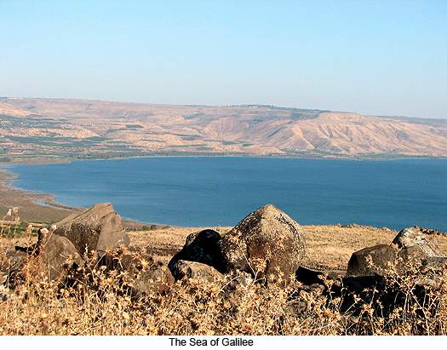
Judah shouldn't look to the big powers but to Galilee (9:1-5).

Slide 47
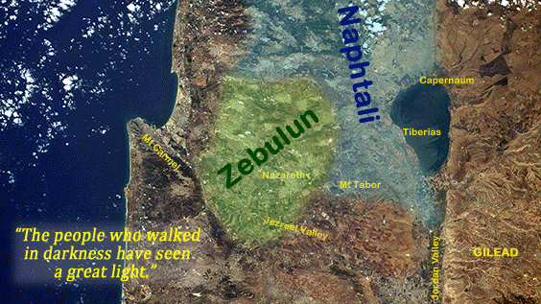
"Nevertheless, that time of darkness and despair will not go on forever. The land of Zebulun and Naphtali will be humbled, but there will be a time in the future when Galilee of the Gentiles, which lies along the road that runs between the Jordan and the sea, will be filled with glory" (Isaiah 9:1 NLT).

Slide 48
"[Jesus] went first to Nazareth, then left there and moved to Capernaum, beside the Sea of Galilee, in the region of Zebulun and Naphtali. ¹⁴This fulfilled what God said through the prophet Isaiah:
Isaiah 9:3-5?
NOT fulfilled yet!
Capernaum
Nazareth
'In the land of Zebulun and of Naphtali,
beside the sea, beyond the Jordan River,
in Galilee where so many Gentiles live'"
(Matt. 4:13-15 NLT)

Slide 49
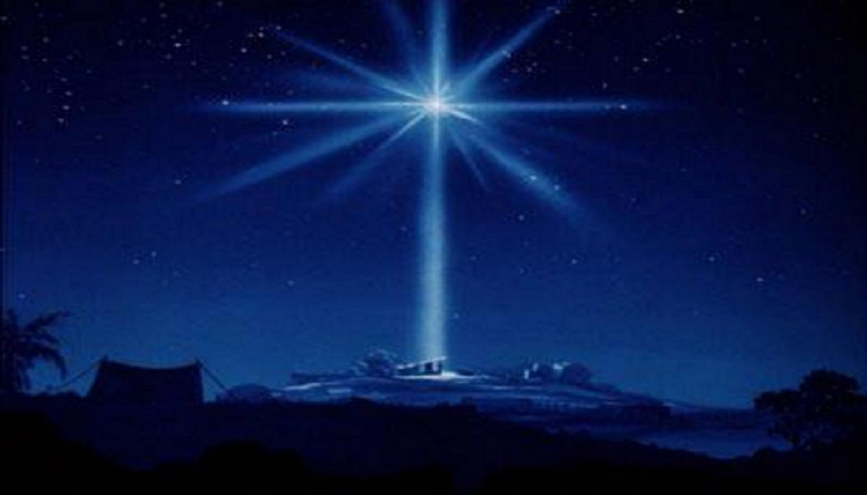
The Son's Kingly Character
Wonderful Counselor
(listened to!)
Mighty God
(Ultimate Power)
Eternal Father
(fatherly rule)
Prince of Peace
(security at last!)
Notes:
Everlasting Father: Christ will rule forever (6e). This refers to…
1. His deity,
2. His relationship to time, not to other members of the Trinity,
3. His "fatherly rule,"
4. His eternal kingdom will fulfill the Davidic Covenant where David was promised a descendant who would rule the world forever.

Slide 50
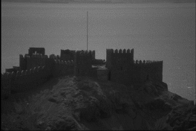
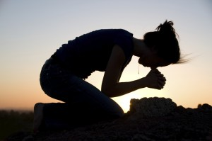
When you need security, look to the Child.
Main Idea of Isaiah 9:

Slide 51
Slides on
Isaiah 11
Notes:
Isaiah 11 gives even more amazing prophecies about the animals during the kingdom.

Slide 52
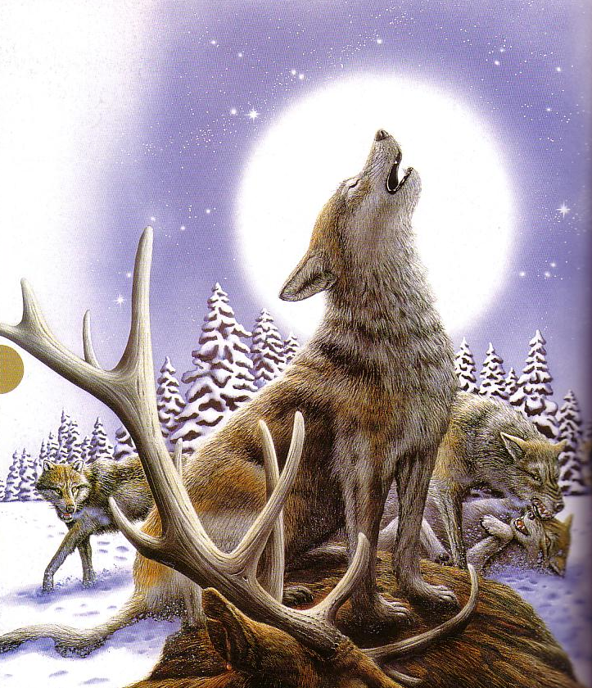
Wolves now love
…to kill

Slide 53
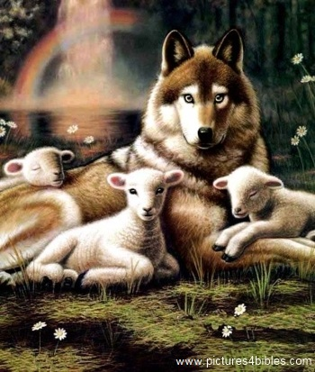
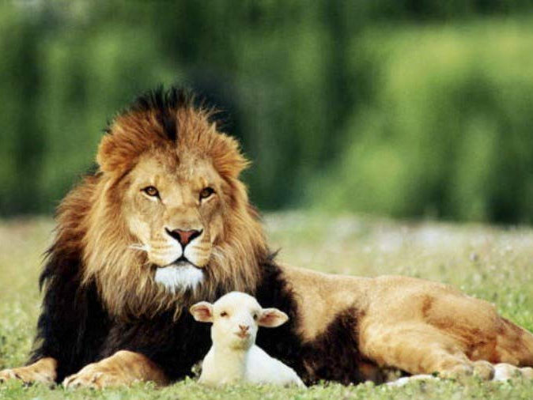
Isaiah 11:6-9
473a
⁶ And the wolf will dwell with the lamb, and the leopard will lie down with the young goat, and the calf and the young lion and the fatling together.
Notes:
53

Slide 54
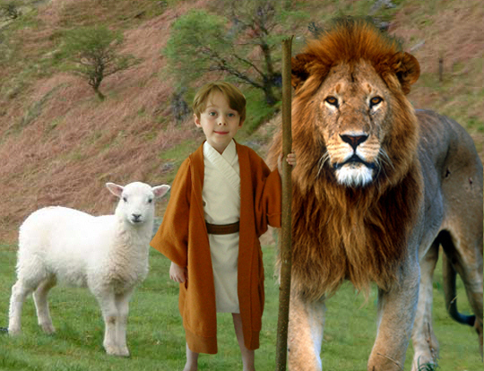
Isaiah 11:6-9
473a
⁶ And the wolf will dwell with the lamb, and the leopard will lie down with the young goat, and the calf and the young lion and the fatling together; and a little boy will lead them.
Notes:
54

Slide 55
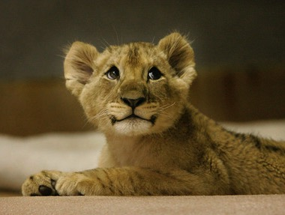
Isaiah 11:6-9
473a
⁷ Also the cow and the bear will graze, their young will lie down together, and the lion will eat straw like the ox.
Notes:
55

Slide 56
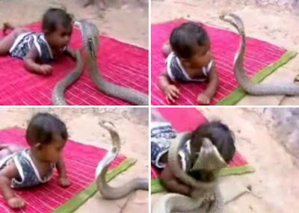
Isaiah 11:6-9
473a
⁸ The nursing child will play by the hole of the cobra, and the weaned child will put his hand on the viper's den.
⁹ They will not hurt or destroy in all My holy mountain, for the earth will be full of the knowledge of the LORD as the waters cover the sea.
Notes:
56
http://dailybuzzlive.com/archives/5613
Snake Tries to Eat Baby. Watch Video Before Reading! Now you may be outraged by this video and think that the parents need to have their child taken away for child abuse, but before you jump to any conclusions take a second to read about a culture that most of us know nothing about. - See more at: http://dailybuzzlive.com/archives/5613#sthash.m31WN86t.dpuf
You may think that this baby is some type of super human, being able to withstand sharp poisonous snake bites, it would pretty awesome if this were true. The snake in the video is actually defanged and has no poison whatsoever. In India, as well as Nepal, some Hindus actually worship snakes. This is called Nag Panchami and many children from this culture grow up with and around snakes. Some people even keep and feed them as though they were their children. - See more at: http://dailybuzzlive.com/archives/5613#sthash.m31WN86t.dpuf

Slide 57
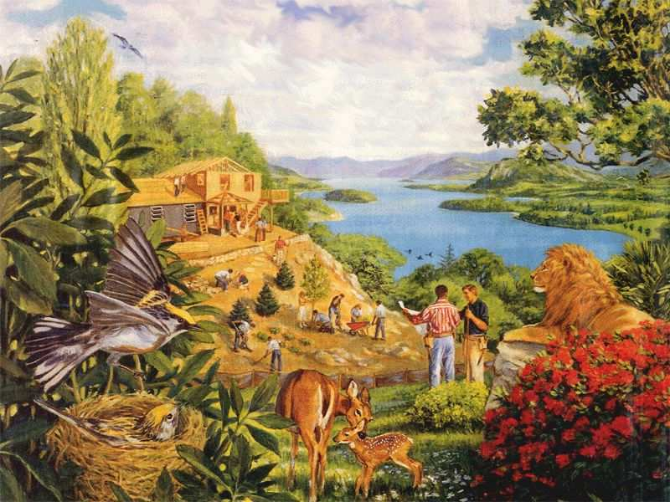
Rebuilding brings…
473a
Notes:
57

Slide 58
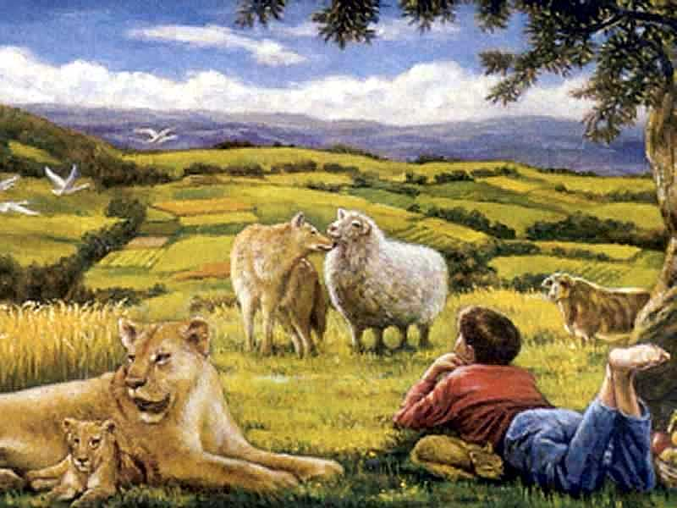
…a totally renewed earth!
473a
Notes:
58

Slide 59
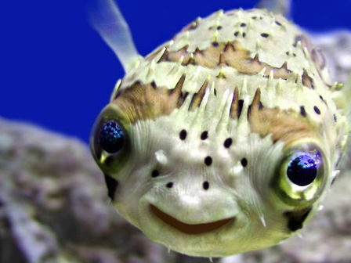
Romans 8:19-21
"The creation waits in eager expectation for the sons of God to be revealed. . . The creation itself will be liberated from its bondage to decay and brought into the glorious freedom of the children of God."
Notes:
59

Slide 60

461b
Millennial Jerusalem
"The law will go out from Zion,
the word of the LORD from Jerusalem"
––Isaiah 2:3
Notes:
60
Jerusalem will be the center of the world’s teaching (Isa 2:4).

Slide 61
Slides on
Isaiah 13
Notes:
Beginning in Isaiah 13, we see that Ahaz should not trust in the twelve-nation coalition since Assyria will defeat it as God's agent of judgment (Isa 13–23).

Slide 62

Judgment on the 12-Nation Coalition (Isa 13–23)
457
Assyria
Phoenicia
Syria
Israel
Babylon
Judah
Philistia
Moab
Babylon by the Sea
Egypt
Edom
Arabia
Ethiopia
Notes:
The temptation for Ahab in Isaiah's time was to trust in a coalition of other nations to fight Assyria—yet God told them to trust him instead. Why? All these nations would fall to Assyria since God had appointed it. The Assyrians later destroyed the northern nation of Israel during Isaiah’s lifetime—as well as 46 cities of Judah.
In such a time of calamity, whom would Judah trust?
So, for 11 chapters, God tells Judah not to trust in…
13:1–14:27 Babylon
14:28-32 Philistia
15–16 Moab
17 Damascus/Israel
18 Ethiopia
19–20 Egypt
21:1-10 Babylon by the Sea
21:11-12 Edom
21:13-17 Arabia
22 Jerusalem
23 Tyre

Slide 63
Slides on
Isaiah 24
Notes:
The worldwide Tribulation will refine and restore Judah since God has not forgotten his covenant (Isa 24–27).

Slide 64
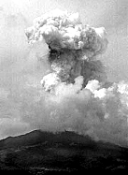
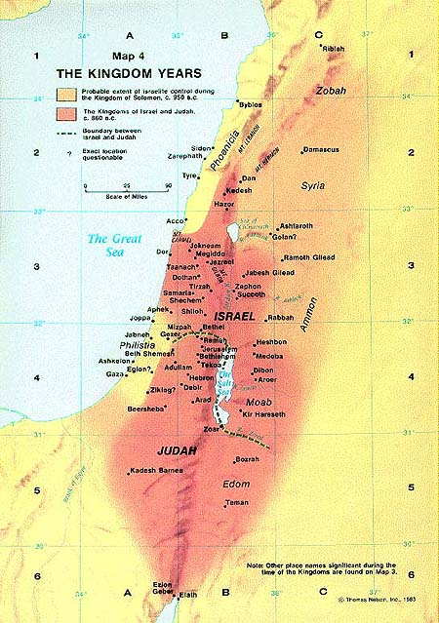
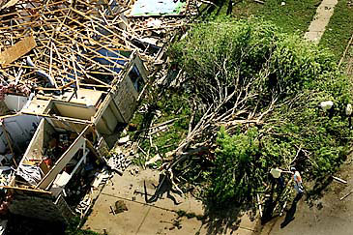
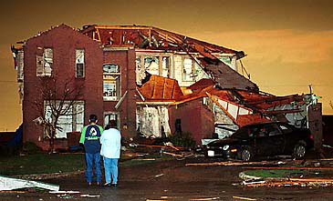
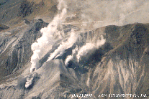
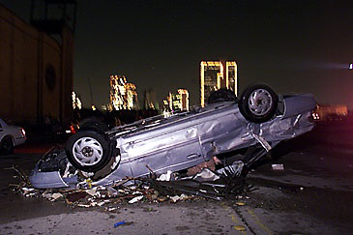


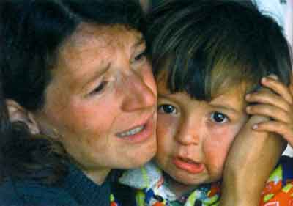

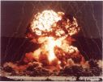
Isaiah 24–25
Worldwide Judgment & Blessing
Depicts the Great Tribulation followed by the Millennium
Notes:
64
This Tribulation is described in great detail in Revelation 6–19.

Slide 65
How will God complete his plan for all creation?
Notes:
By what means will the LORD restore the entire universe (restatement)?

Slide 66
Be Complete
Judgment
1–39
God will judge those who reject him (Isa 1–39).
Notes:
The LORD will deal with unbelievers in a just manner (restatement).

Slide 67
Be Complete
Judgment
Salvation
1–39
40–66
God will save those who trust him (Isa 40–66).
Notes:
The LORD will deliver the people who believe in him.
God will bless all peoples and rule through Messiah.

Slide 68
Slides on
Isaiah 40
Notes:
God will punish Babylon and restore Judah with his shepherd heart and knowledge of the future so Judah should reject Babylon's idols (Isa 40–48).

Slide 69

How can you look up to the LORD during your struggle?
Notes:
Now, in light of the challenge that you are facing, let's address this question: How can you look up to the LORD during your struggle?

Slide 70

God would tenderly replace His discipline with His glory and Word (40:1-11).

Slide 71

Isaiah 40:1
Notes:
God's discipline would end after the exile (1-2).
"Comfort, comfort" refers to being restored.

Slide 72

Isaiah 40:2 NLT
"Speak tenderly to Jerusalem.
Tell her that her sad days are gone
and her sins are pardoned.
Yes, the LORD has punished her twice over for all her sins."
Notes:
That would happen because the discipline was complete.

Slide 73

Isaiah 40:12b NLT
Who has measured off the heavens with his fingers?
Who else knows the weight of the earth
or has weighed the mountains and hills on a scale?
Notes:
He's bigger than outer space, the earth, mountains, and hills (12b).

Slide 74

Isaiah 40:15 NLT
No, for all the nations of the world are but a drop in the bucket. They are nothing more than dust on the scales. He picks up the whole earth as though it were a grain of sand.
Notes:
The nations are nothing compared to God.

Slide 75

All the wood in Lebanon's forests and all Lebanon's animals would not be enough to make a burnt offering worthy of our God.
Isaiah 40:16 NLT
Notes:
75
The best forests are nothing compared to God.

Slide 76

Isaiah 40:27 NLT
O Jacob, how can you say the LORD does not see your troubles? O Israel, how can you say God ignores your rights?
Notes:
Don't have a pity party!

Slide 77

Isaiah 40:28 NLT
Have you never heard? Have you never understood? The LORD is the everlasting God, the Creator of all the earth. He never grows weak or weary. No one can measure the depths of his understanding.
Notes:
Since God never grows tired, He can strengthen you (28-31).

Slide 78

Isaiah 40:29-30 NLT
²⁹He gives power to the weak and strength to the powerless.
³⁰Even youths will become weak and tired, and young men will fall in exhaustion.

Slide 79

Isaiah 40:31 NLT
But those who trust in the LORD will find new strength.
They will soar high on wings like eagles.
They will run and not grow weary.
They will walk and not faint.
Notes:
Did you know an eagle knows when a storm is approaching long before it breaks?

Slide 80

Isaiah 40:31 NLT
…They will soar high
on wings like eagles…
Notes:
The eagle will fly to some high spot and wait for the winds to come. When the storm hits, it sets its wings so that the wind will pick it up and lift it above the storm. While the storm rages below, the eagle is soaring above it. It doesn't escape the storm. It uses it to lift it higher. It rises on the storm's winds!

Slide 81

Main Idea of Isaiah 40
He cares and He's able,
so trust Him
Notes:
So what's the point of Isaiah 40? Simply, He cares and He's able, so trust Him.

Slide 82
Slides on
Isaiah 53
Notes:
God’s Suffering Servant will restore Judah and bless the Gentiles in his vicarious death so the remnant should trust him now (Isa 49–57).

Slide 83



The Same Messiah?
"He will rule with fairness and justice from the throne of his ancestor David for all eternity"
(9:7)
"He was despised and rejected—a man of sorrows, acquainted with deepest grief…"
(53:3)
Notes:
83
Jewish scholars of the intertestamental period could not reconcile Isaiah's two seemingly contradictory depictions of the Messiah. Therefore, some thought there existed two Messiahs—one to rule and one to suffer. Others said Isaiah 53 depicted not the Messiah but the suffering Jewish people. Of course, we now see that this is the same man Jesus who would suffer in his first coming and reign in his second coming.

Slide 84
Slides on
Isaiah 65
Notes:
Israel’s glorious restoration in the millennium reveals that he will fulfill every promise in the Abrahamic Covenant (Isa 60–66).

Slide 85

Isaiah 65:17-18a (NLT)
"Look! I am creating new heavens and a new earth, and no one will even think about the old ones anymore. ¹⁸Be glad; rejoice forever in my creation!"
Notes:
85

Slide 86
471
Isaiah vs John on the
New Heaven(s) and New Earth
Isaiah 65–66
Revelation 21
Death occurs
(Isa. 65:20, 66:24)
No more death, dying or pain (Rev. 20:14, 21:4)
Marriage & childbirth
(Isa. 65:20)
No marriage (Matt. 22:30)
Has a temple, Priests & Levites (Isa. 66:18-20;
Zech. 14:16-19)
Has no temple (Rev. 21:22)
New moon and Sabbath celebrated (Isa. 56:6-7; 66:23)
No need for sun or moon (Rev. 21:23); There are no days in the New Heaven.
Notes:
86

Slide 87
Two "New Heaven(s) & New Earth"
473
2nd Advent
(Isa. 60:2; 61:11)
Great White Throne
(Rev. 20:11-14)
Church Age
Millennium
(Isa. 2:4; 65:20)
Eternal State
(Rev. 22:5)
Isaiah's
New Heavens
& New Earth
(Isa. 54–66)
John's
New Heaven
& New Earth
(Rev. 21–22)
Notes:
87

Slide 88


What Kind of Kingdom Did Isaiah
(and Matthew) Envision?
461b
Political
Physical
Emotional
Intellectual
Spiritual

Slide 89
How will God complete his plan for all creation?
Notes:
By what means will the LORD restore the entire universe (restatement)?

Slide 90
The Main Idea of Isaiah
Judgment
Salvation
1–39
40–66
God will both judge and save his creation.
Notes:
The LORD will deal justly and mercifully with all that he made (restatement).

Slide 91
Be Complete
Judgment
1–39
God will judge those who reject him (Isa 1–39).
Notes:
The LORD will deal with unbelievers in a just manner (restatement).

Slide 92
Be Complete
Judgment
Salvation
1–39
40–66
God will save those who trust him (Isa 40–66).
Notes:
The LORD will deliver the people who believe in him (restatement).

Slide 93
Key Word
452
343
Restoration
Isaiah
Notes:
So what should we do? God will restore the entire earth! This has implications!

Slide 94

452
APPLICATION
The future restoration of the earth should cause us to get our priorities right now
So realize that God is preparing you for your future rule now!
Notes:
94

Slide 95

Jesus Shall Reign
Words: Isaac Watts (Public Domain)
CCLI Song #11026168
Music: 2008 Van Ness Press, Inc.
(Admin. by Music Services, Inc.)
CIC CCLI Licence # 277507
Notes:
In the late 1600s and early 1700s, Isaac Watts was an English Christian minister, hymn writer, and theologian. He was a prolific and popular hymn writer and is credited with some 750 hymns. His theology showed that he believed in a literal millennium where Jesus would rule even with a renewed sacrificial system. This is evident in his 1719 humn "Jesus Shall Reign." Note the future—that Jesus shall rule in the days ahead.
http://www.lyricsondemand.com/miscellaneouslyrics/christianlyrics/jesusshallreignwhereerthesunlyrics.html

Slide 96
Jesus Shall Reign
Jesus shall reign where'er the sun
Doth his successive journeys run
His Kingdom stretch from shore to shore,
Till moons shall wax and wane no more.
To Him shall endless prayer be made.
And princes throng to crown His head,
His name like sweet perfume shall rise
With every morning sacrifice.
Notes:
Watts understood that Christ's future rule would be over the entire earth and would be so until the moon no longer waxed and waned. Since the eternal state will have neither sun nor moon (Rev. 21:4), Watts was referring to the earthly reign of Christ in the future millennium after the Second Coming.
______________
http://www.lyricsondemand.com/miscellaneouslyrics/christianlyrics/jesusshallreignwhereerthesunlyrics.html

Slide 97
Black

Slide 98


OT Preaching link at BibleStudyDownloads.org
Get this presentation and script for free!

